Slide 1
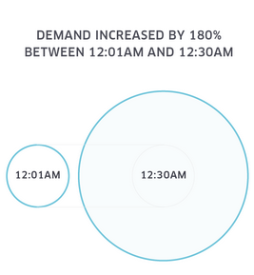
http://blog.visme.co/bad-infographics/

Slide 2

http://blog.visme.co/bad-infographics/

Slide 3
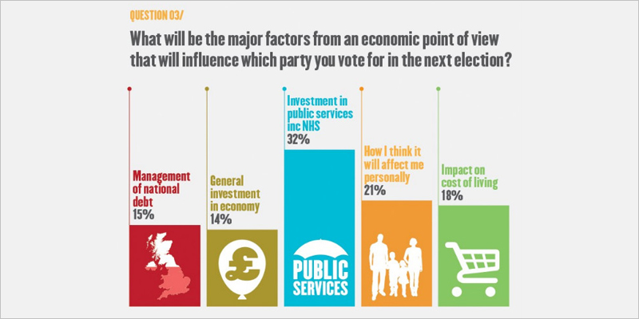
http://blog.visme.co/bad-infographics/

Slide 4
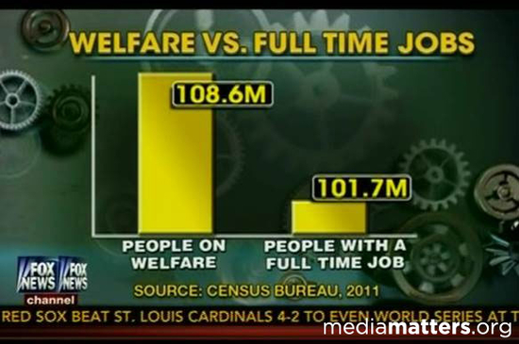
http://blog.visme.co/bad-infographics/

Slide 5
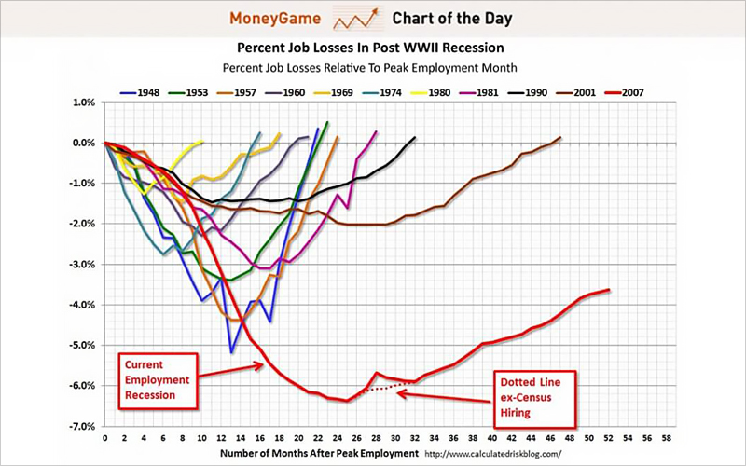
http://blog.visme.co/bad-infographics/

Slide 6

http://blog.visme.co/bad-infographics/

Slide 7
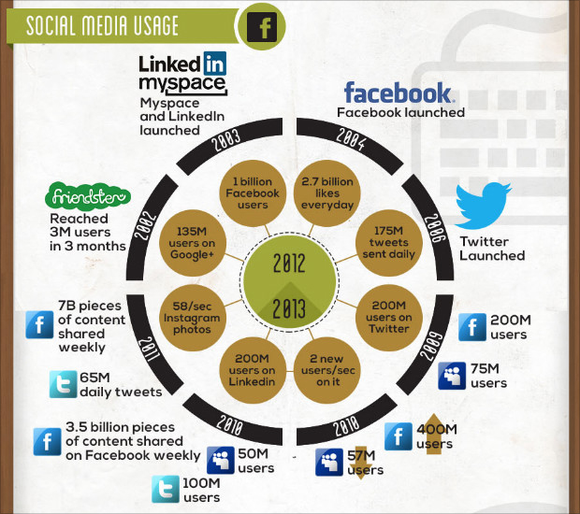
http://blog.visme.co/bad-infographics/

Slide 8
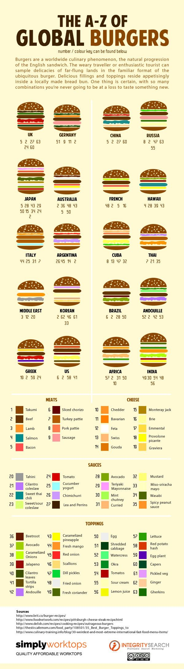
http://blog.visme.co/bad-infographics/

Slide 9
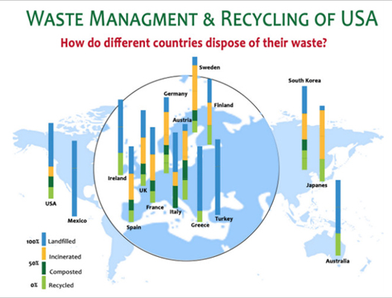
http://blog.visme.co/bad-infographics/

Slide 10
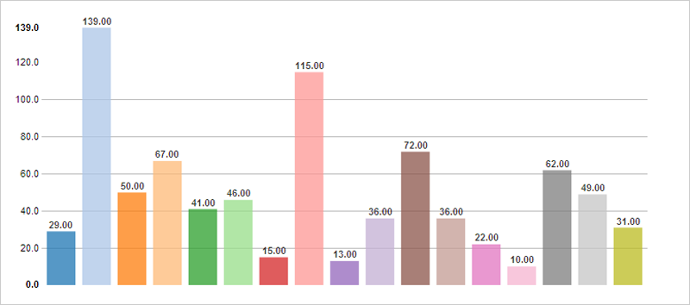
http://blog.visme.co/bad-infographics/

Slide 11

http://blog.visme.co/bad-infographics/

Slide 12
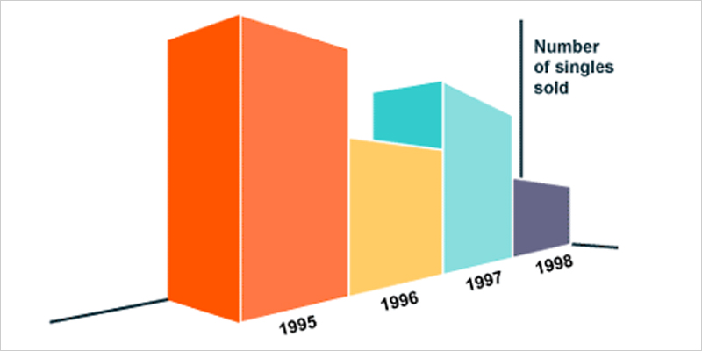
http://blog.visme.co/bad-infographics/

