Slide 1

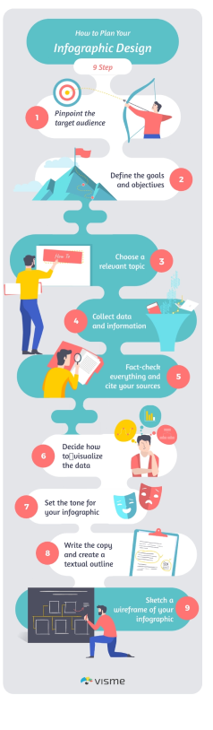
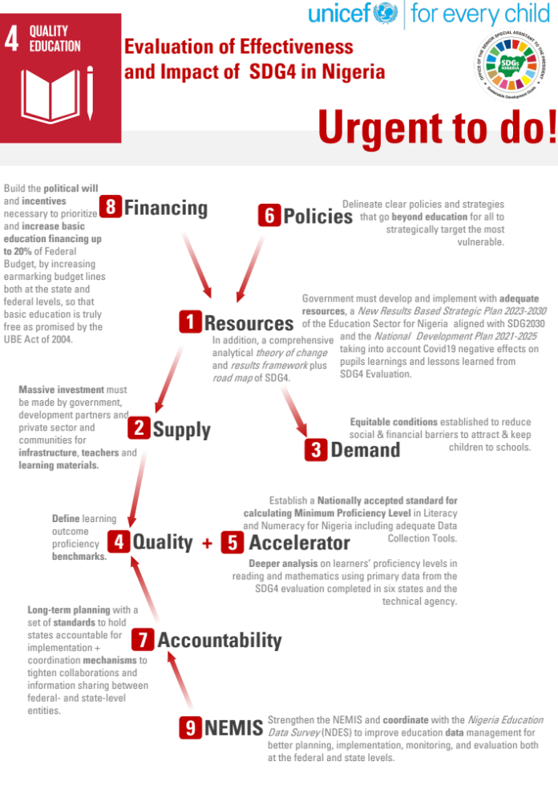
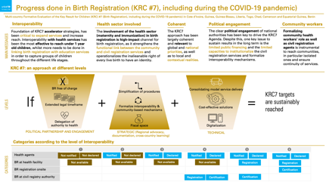



Products
Infographic
(1 page)
Visual executive summaries
(6-10 pages)
Infographics (2 pages)
Traditional report (150 pages)
Infographic RRSS (scroll)
Video
Flyers
Internet Site
Poster

Slide 2
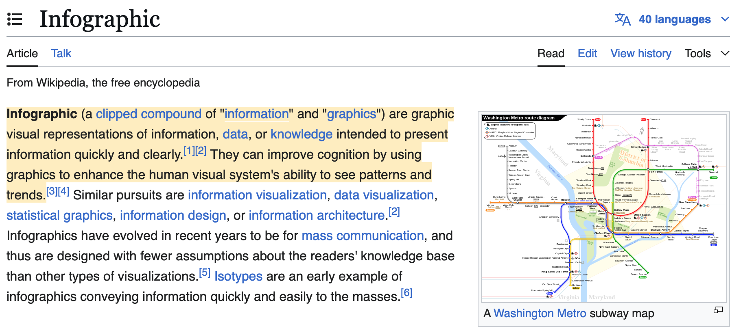
Infographics

Slide 3
Infographics
Information carried on a graph
Marketing tool that uses texts and images to better convey information
Computer-assisted image creation
Information + graphics: translating information into a visual form
Set of visual creations based on information and data
Set of techniques that allow data to be represented visually
Visualization (visual presentation) of quantitative and qualitative information
Visual communication tool that uses images and graphics to convey information
Synthetic

Slide 4
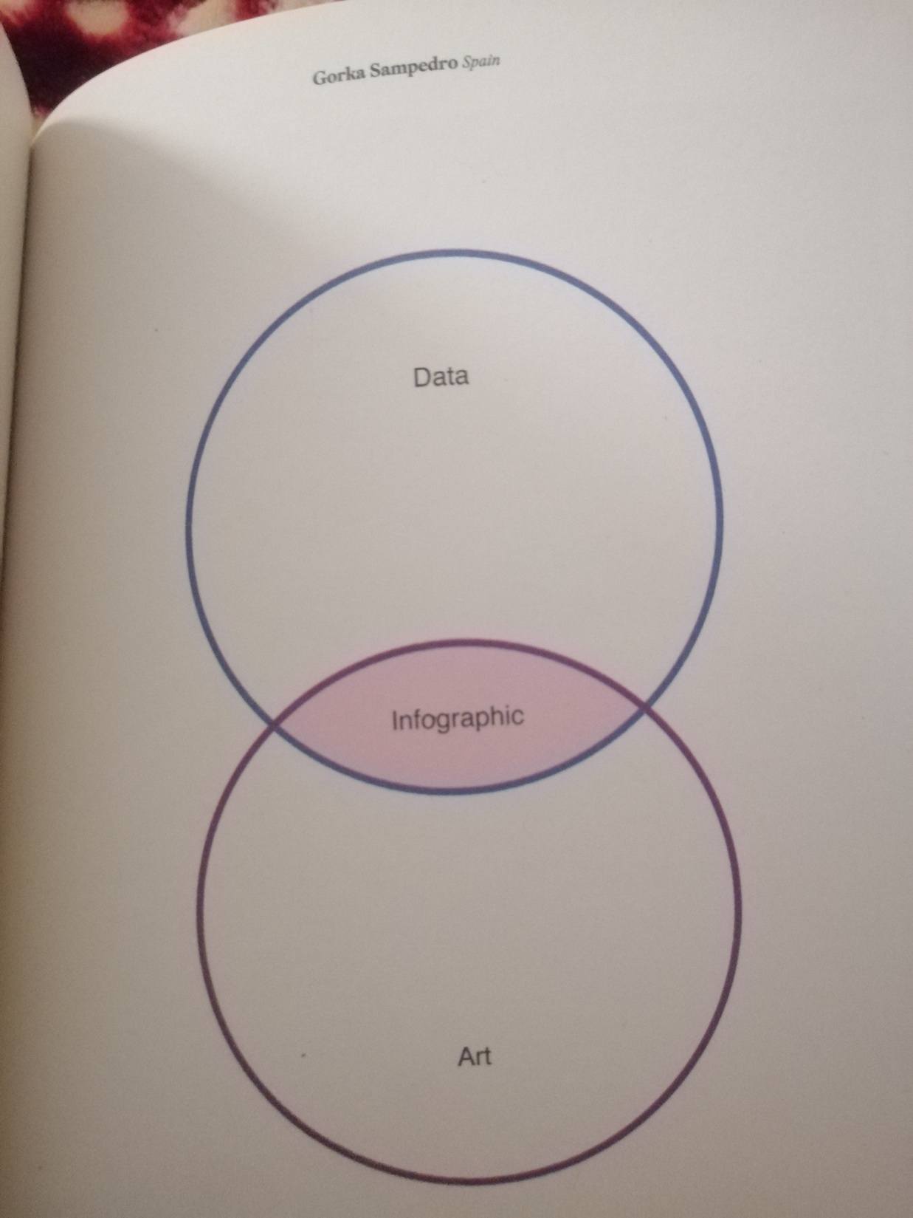

Slide 5
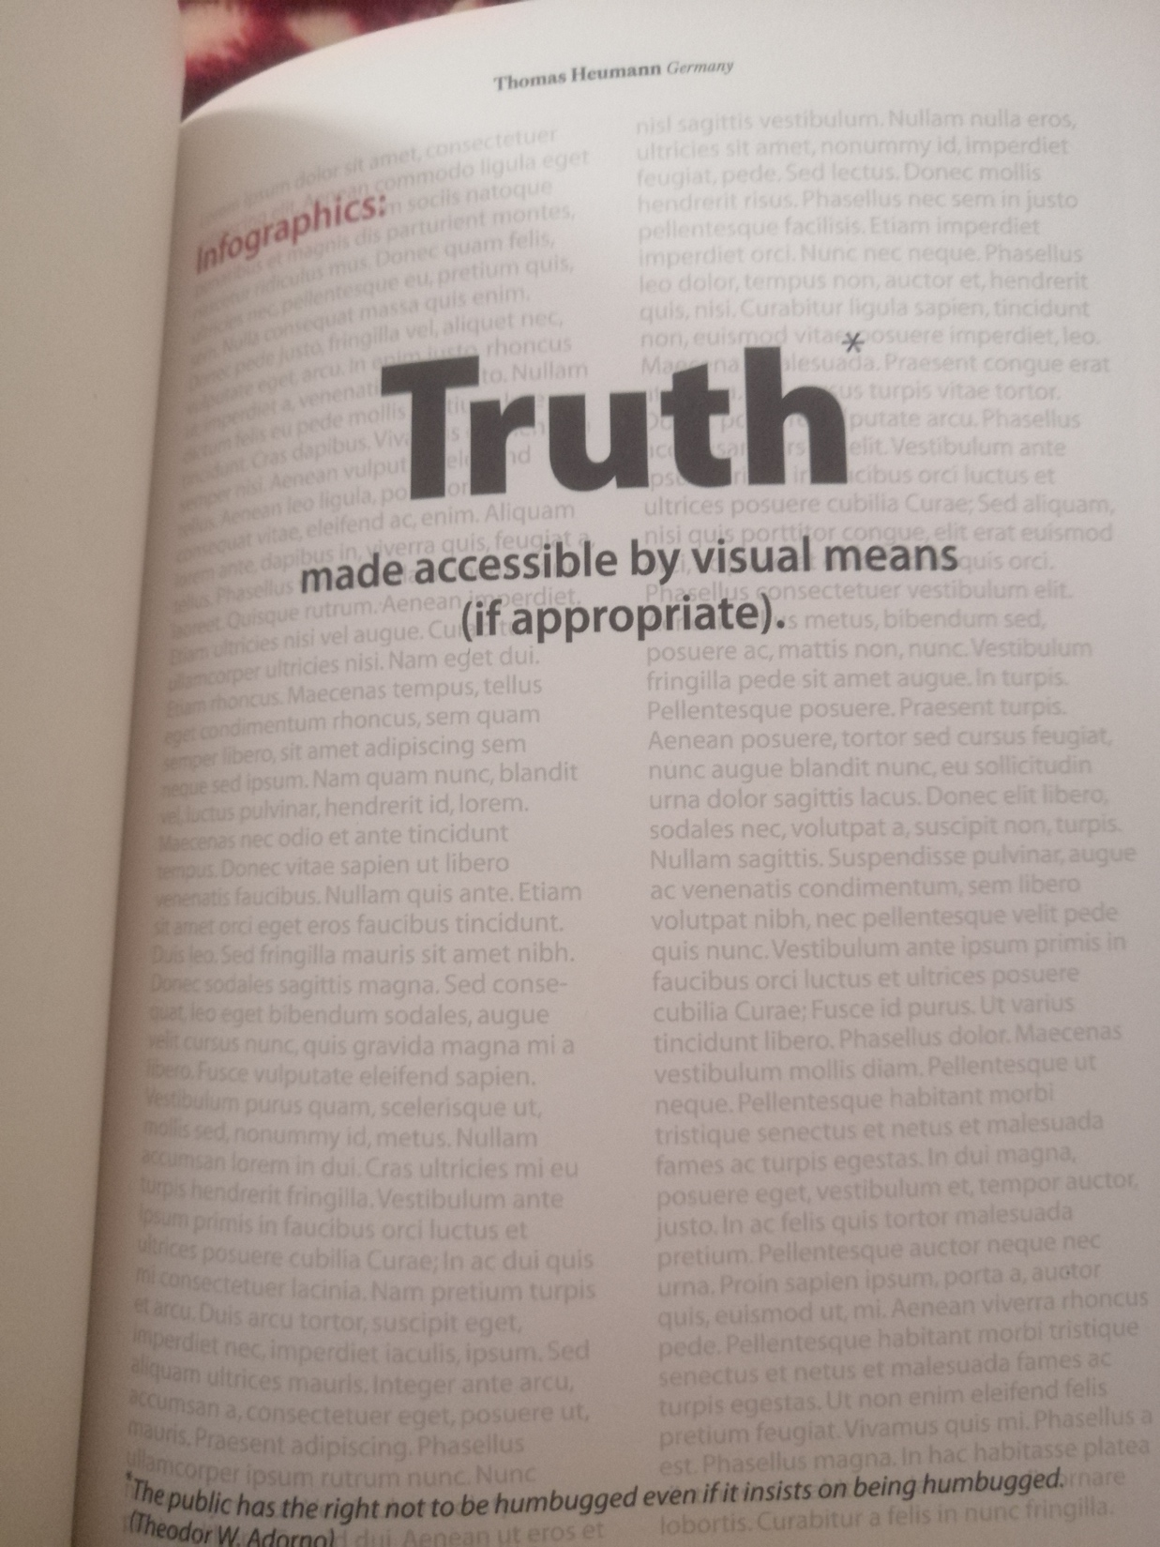

Slide 6


Slide 7
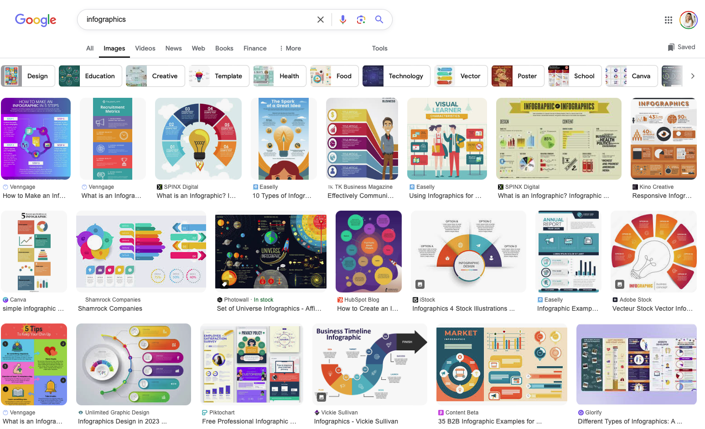

Slide 8
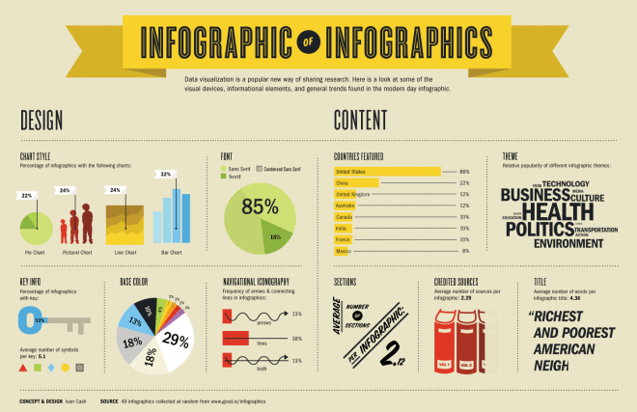
Infographics

Slide 9
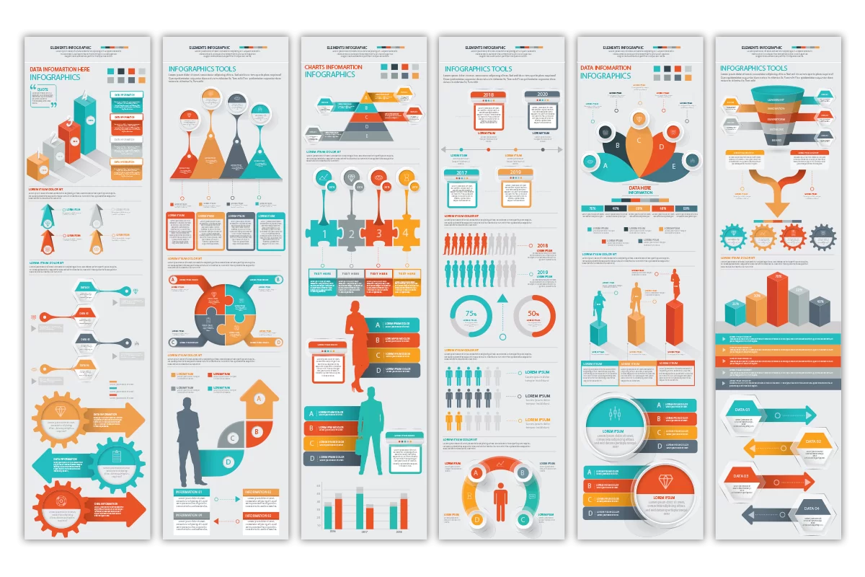
Infographics

Slide 10
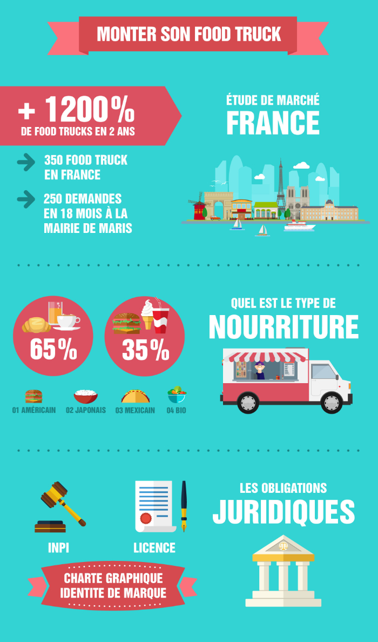
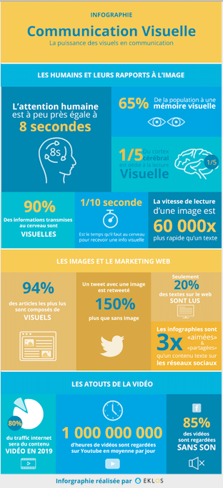
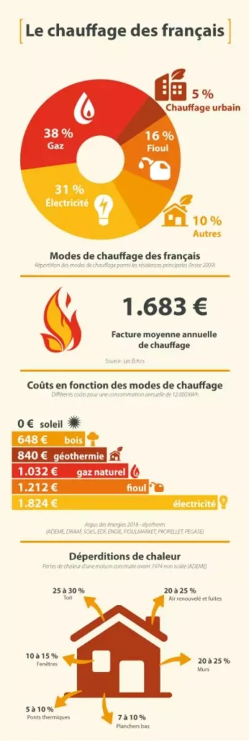
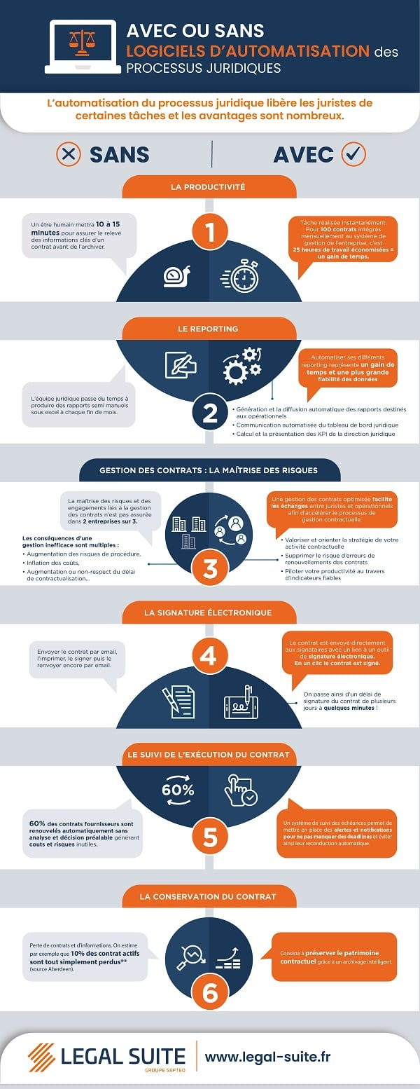

Slide 11
Infographics
(stand-alone product that provides a story, a message)
100% visual
INFOGRAPHICS
VISUAL REPORTS
100% text
1 page
2 pages
3 pages
4 pages
More

Slide 12
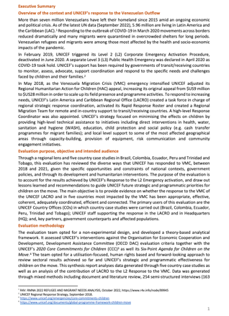
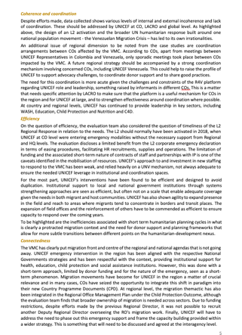
Evaluation
Brief .

Slide 13
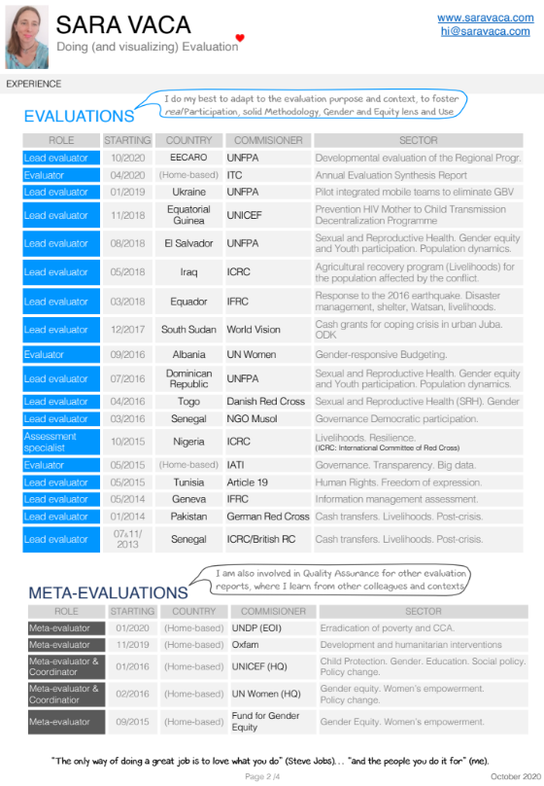
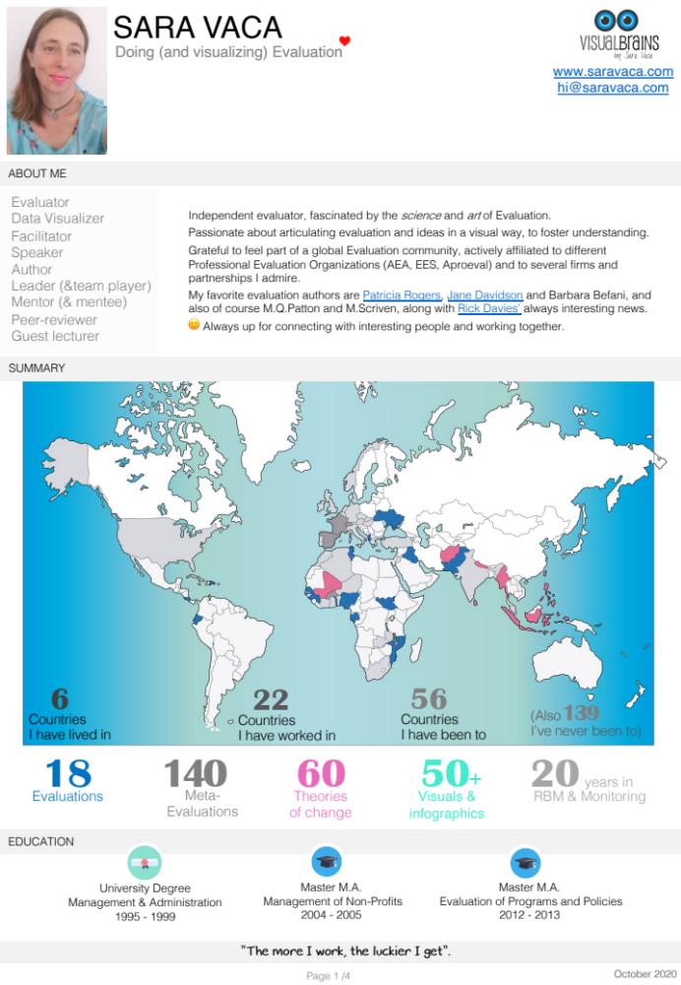
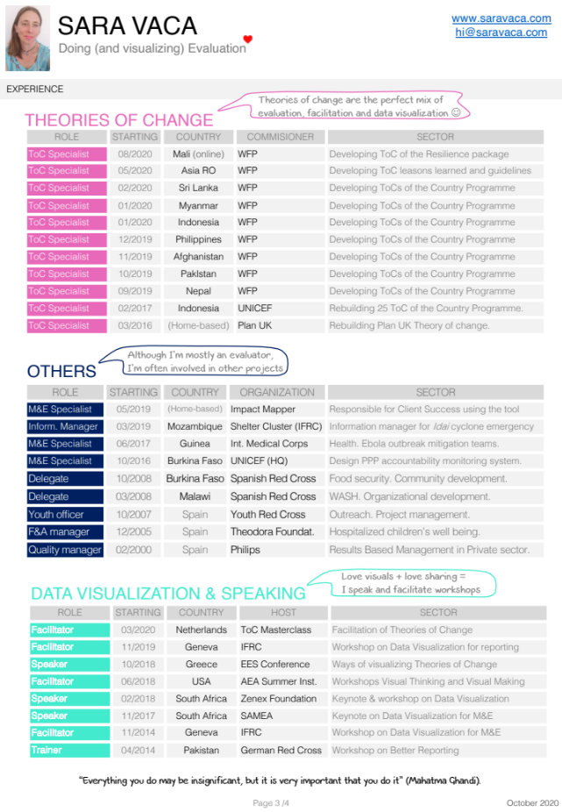
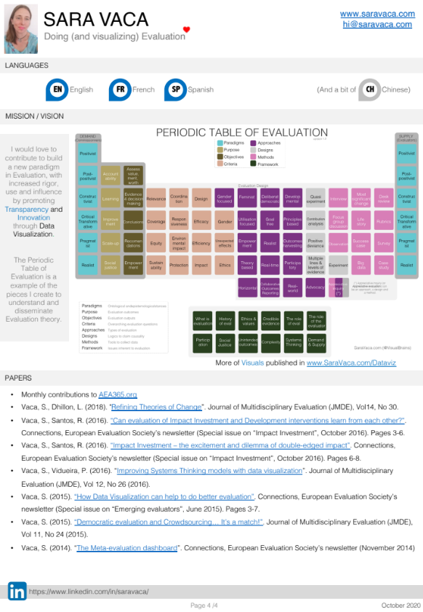

Slide 14
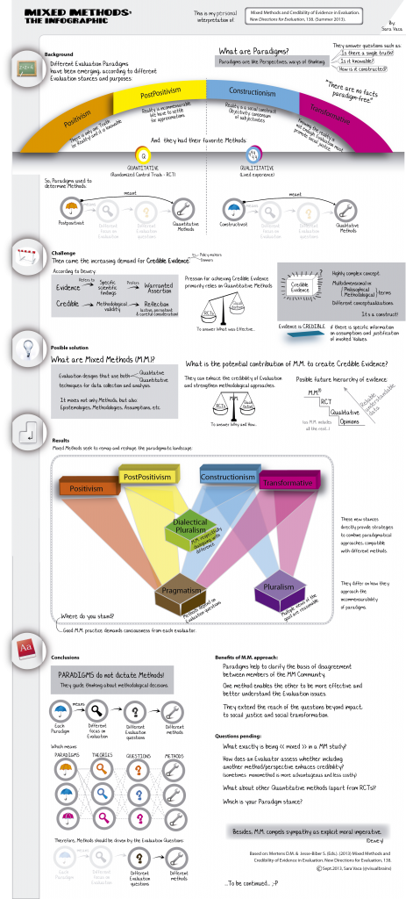

Slide 15
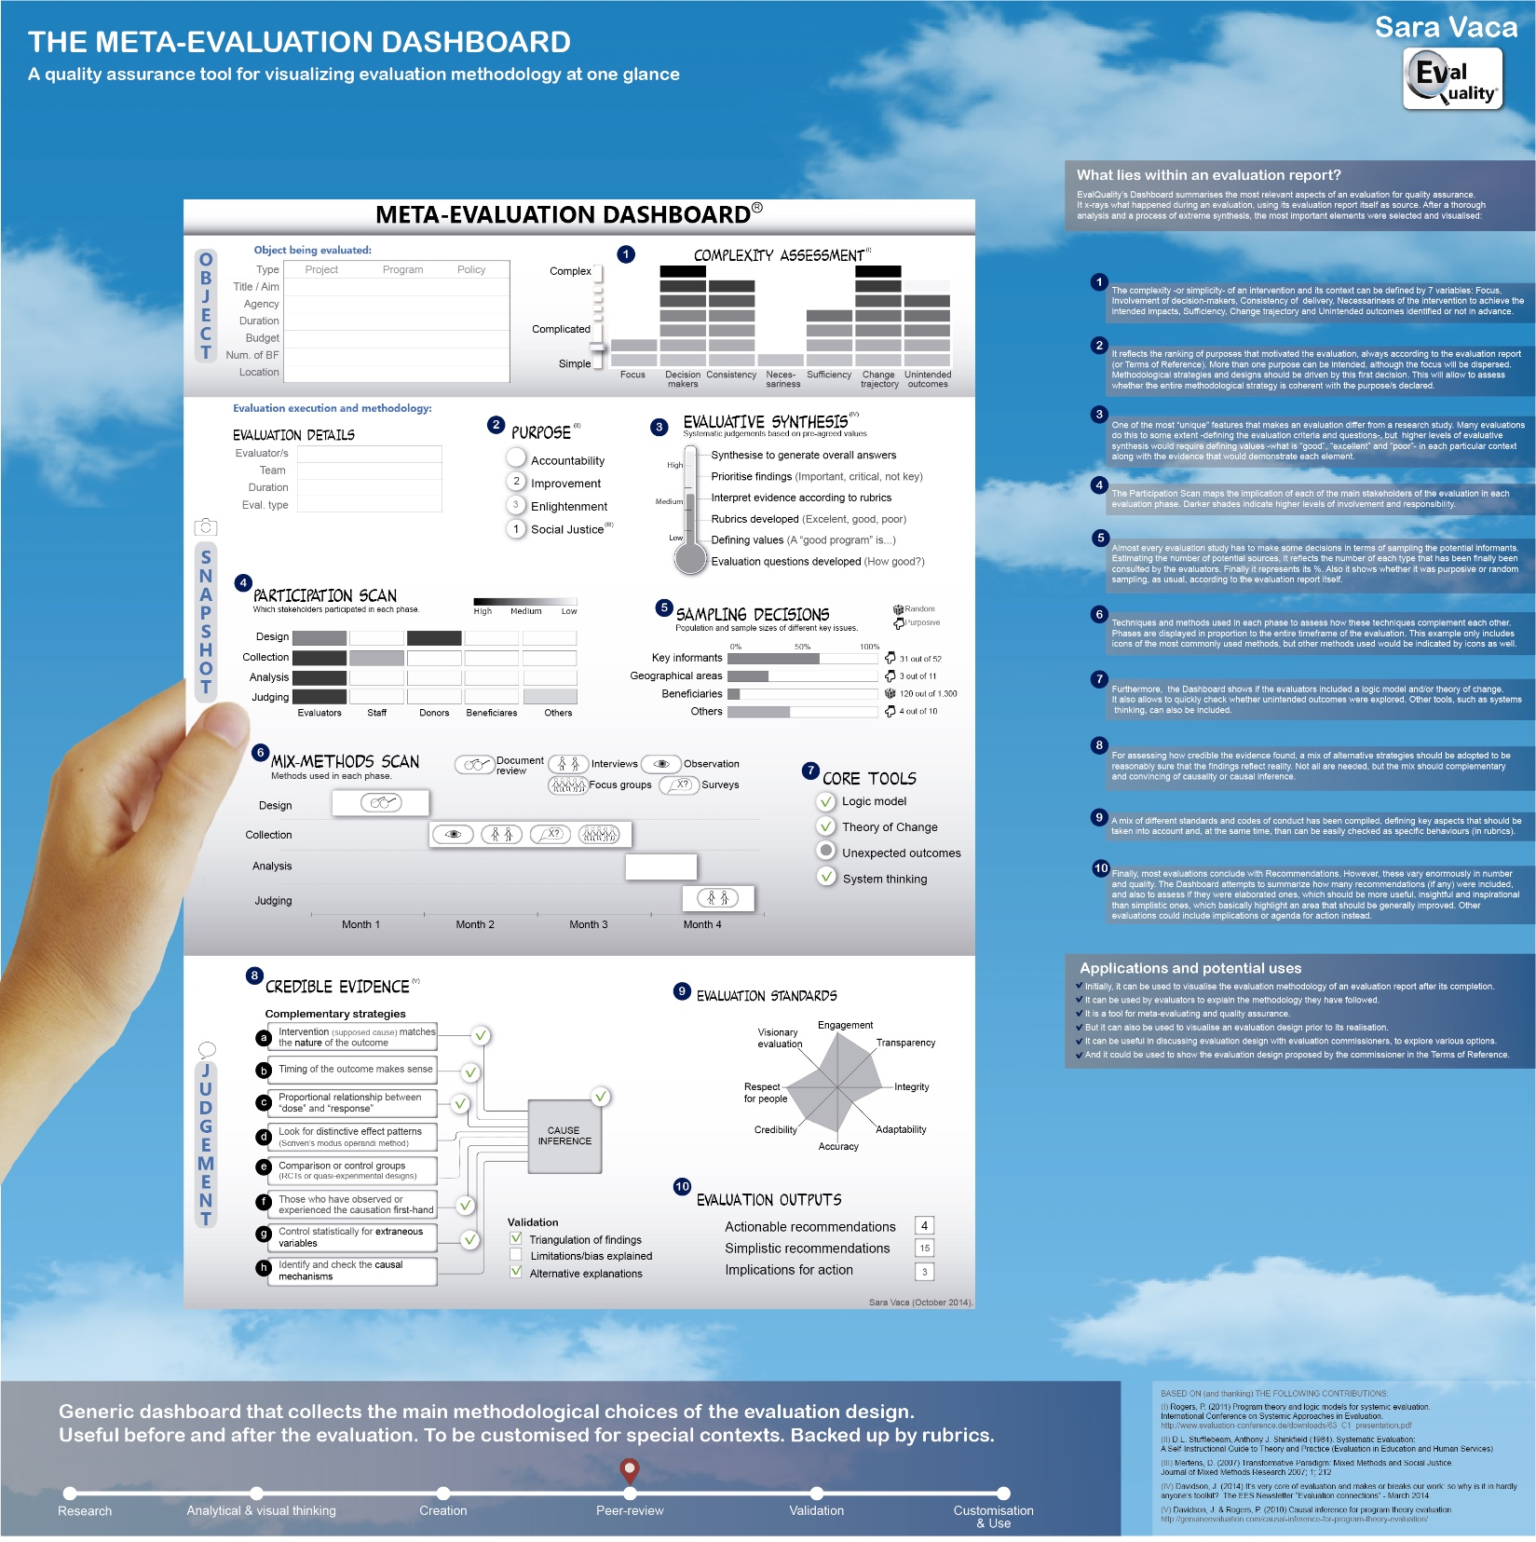

Slide 16
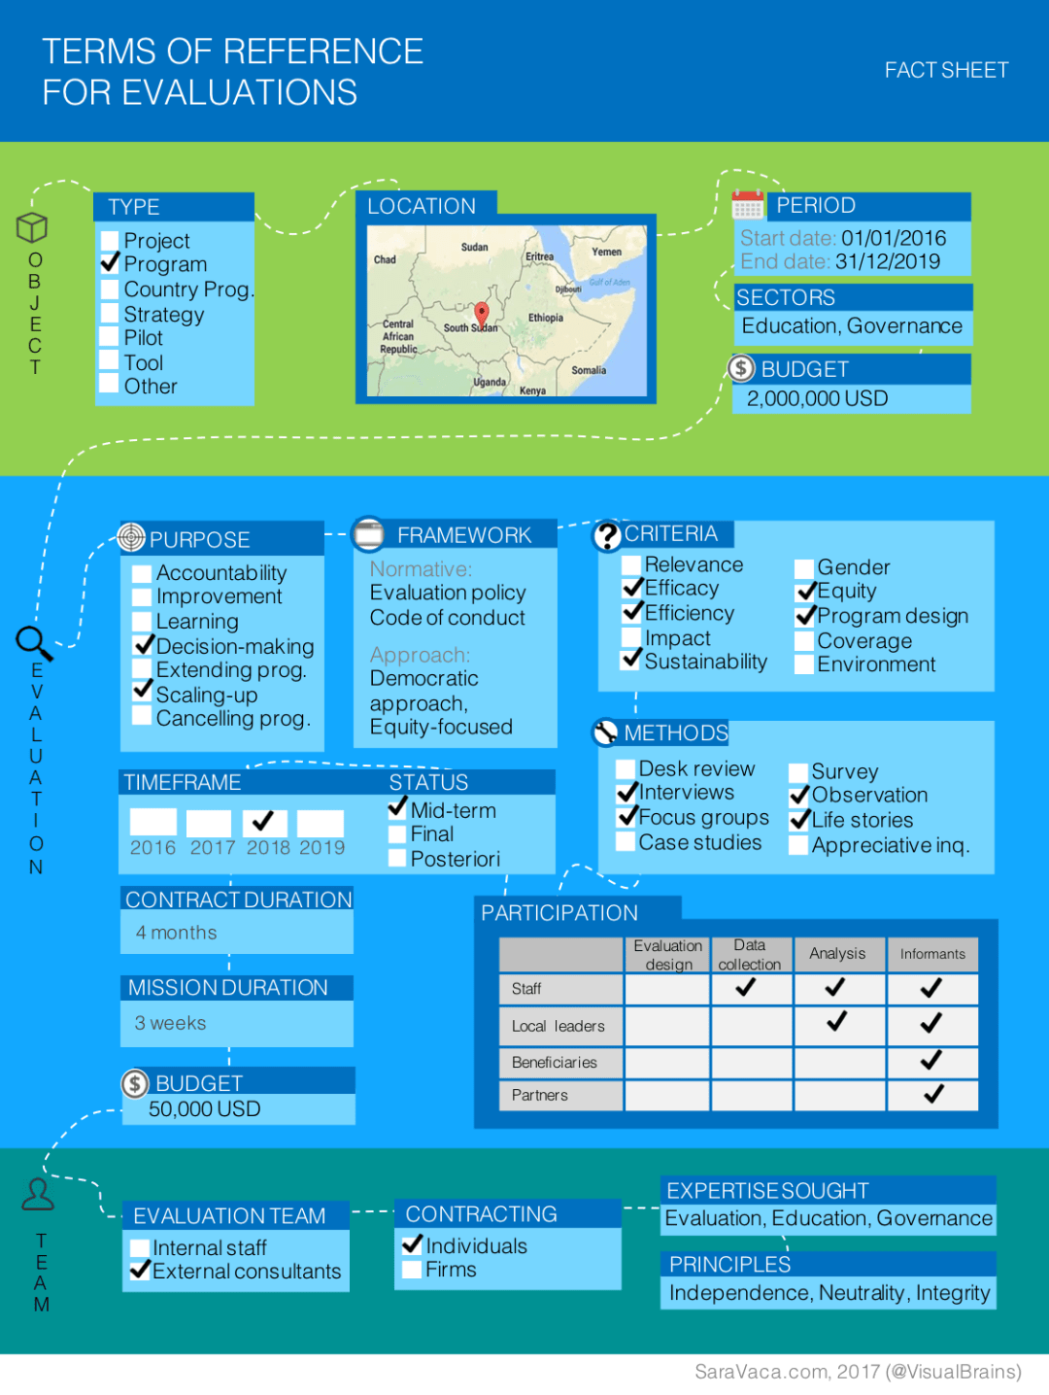

Slide 17
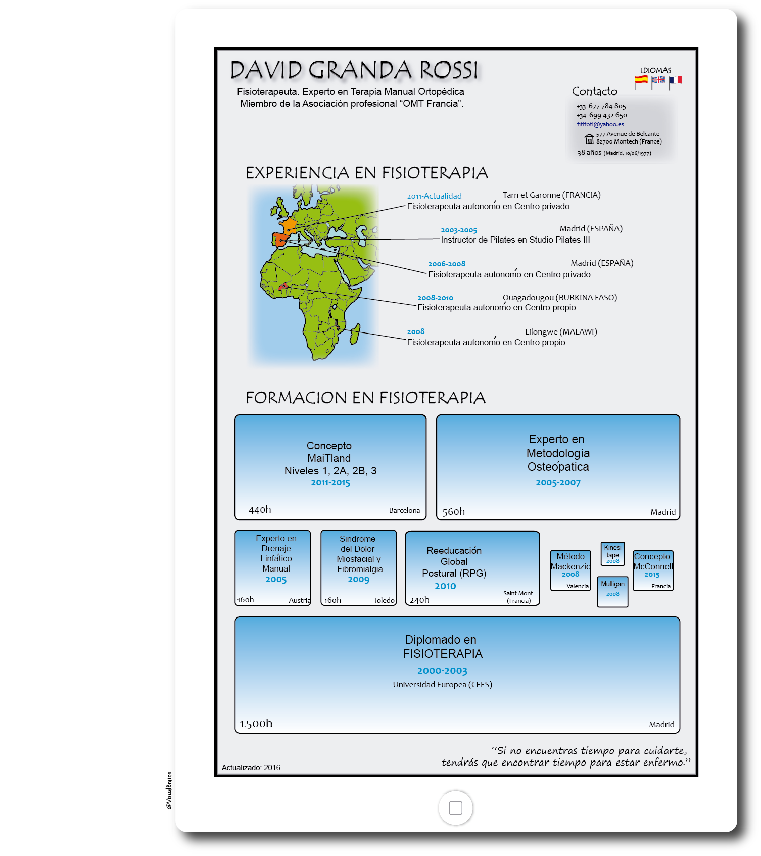
Visual CVs

Slide 18
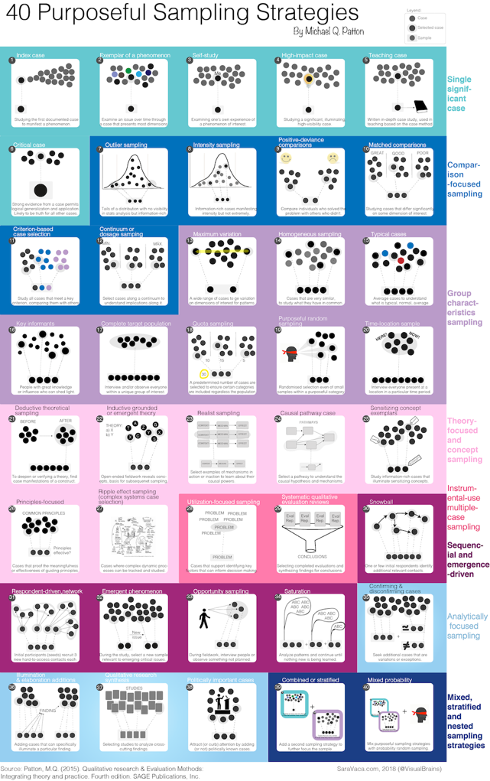

Slide 19
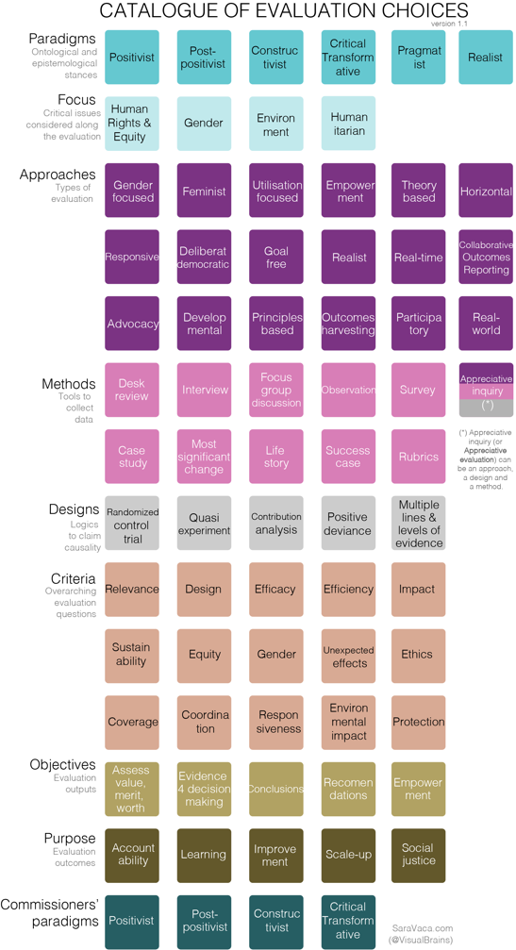

Slide 20
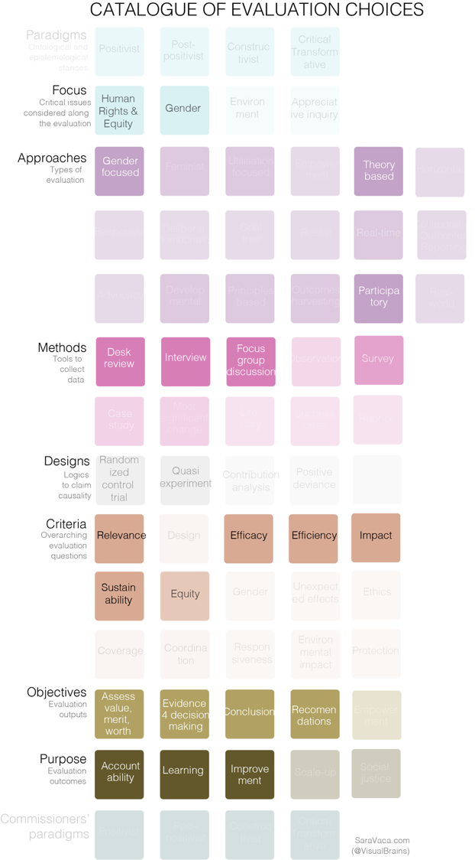
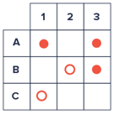
Matrix

Slide 21
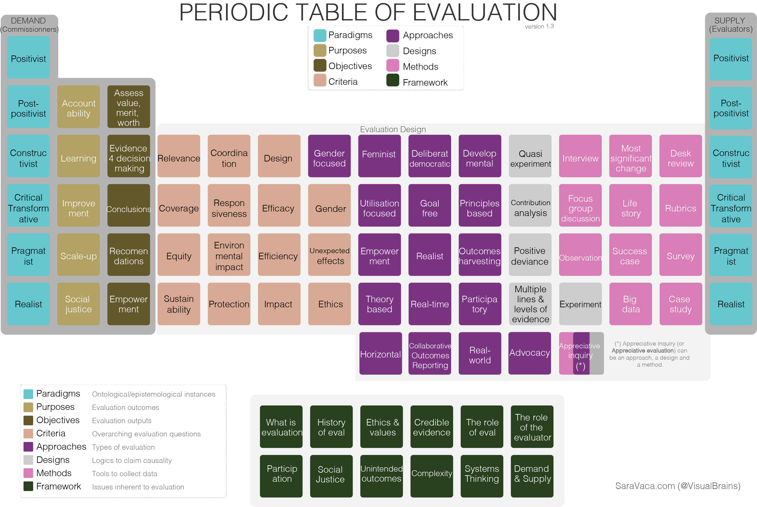
Matriz

Slide 22
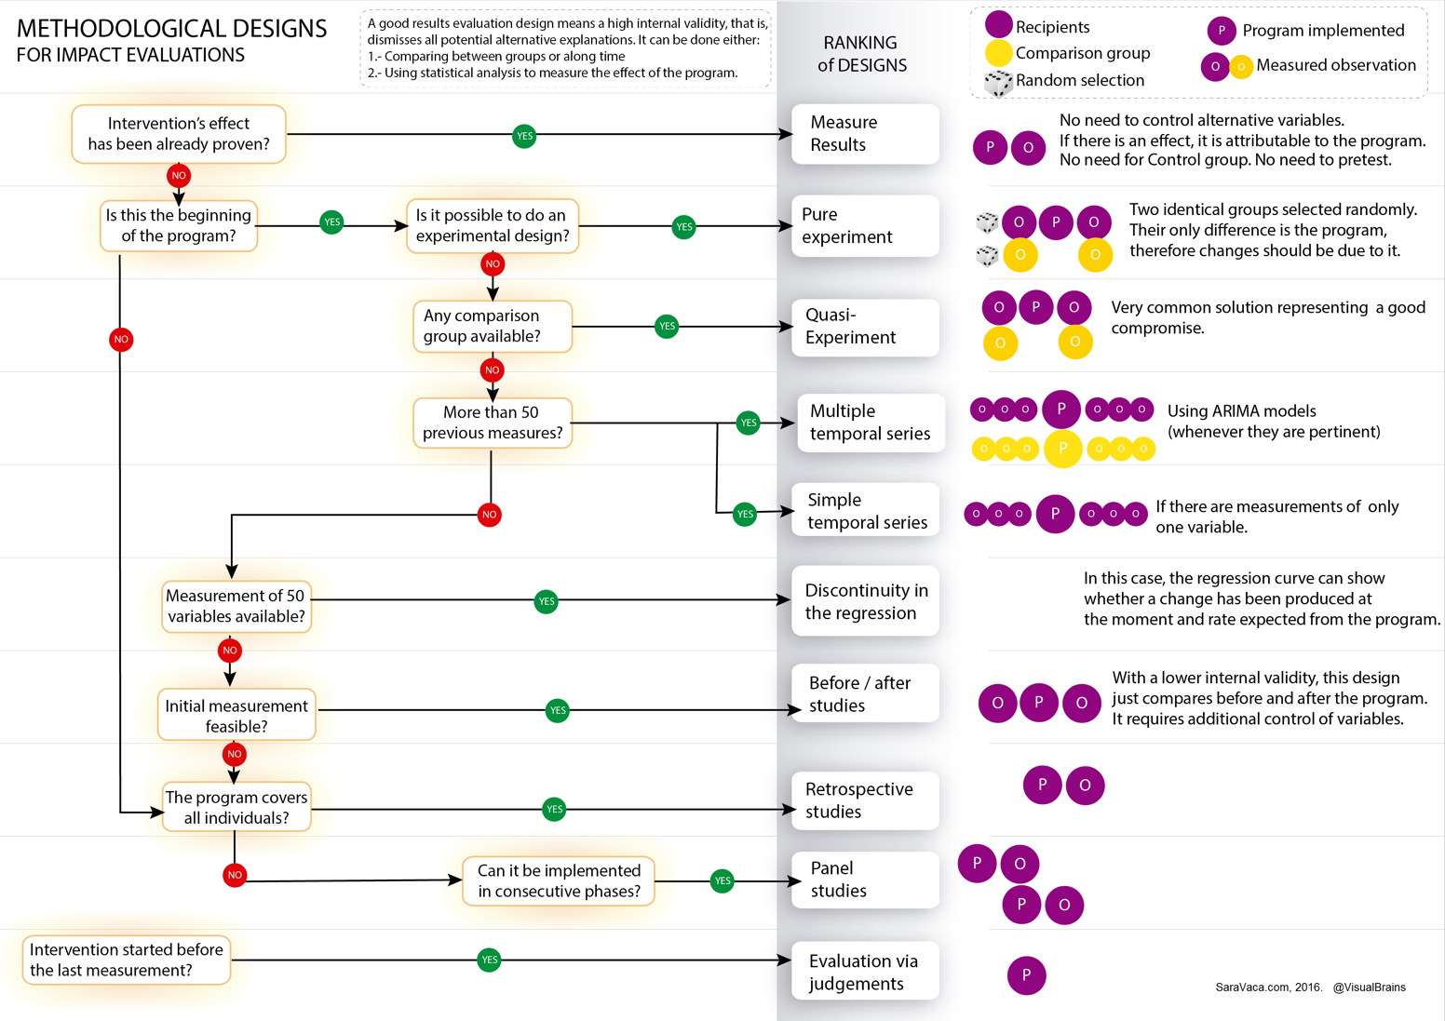
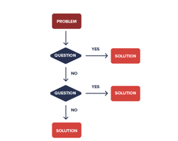
Arbol de decisión

Slide 23
Infographics
(stand-alone product that provides a story, a message)
100% visual
INFOGRAPHICS
VISUAL REPORTS
100% text
1 page
2 pages
3 pages
4 pages
More

Slide 25
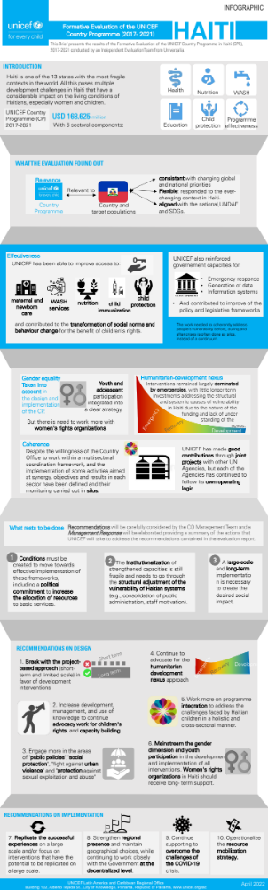

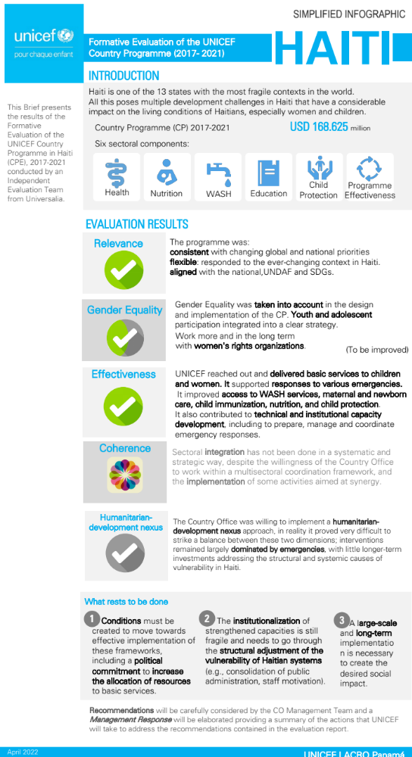
LESSONS LEARNED FROM USING DATA VISUALIZATION TO PROMOTE EVALUTION USE
Infographic
Évaluation du Programme de Pays de l’UNICEF en Haïti (2017-2021)
Type | Formative
Country | Haiti
Year | 2021?
Purpose | To inform the design and implmeenntaiton of the 2022-26 Country Programme
Time of elaboration of the infographic | 3 days
Link to the report | https://www.unicef.org/lac/en/documents/haiti-formative-evaluation-country-programme-2017-2021
Link to the visual | https://www.dropbox.com/s/6qkzb3ztvrmqfwj/Haiti%20Visual%20Infographic%2020220508.jpeg?dl=0 https://www.dropbox.com/s/3g79w6m2tlj0ls4/Visual%20Simplified%20Infographic%20v.1.pdf?dl=0
Notes
UNICEF Latin America and Caribbean Regional Office
Building 102, Alberto Tejada St., City of Knowledge, Panamá, Republic of Panama, www.unicef.org/lac
15

Slide 26
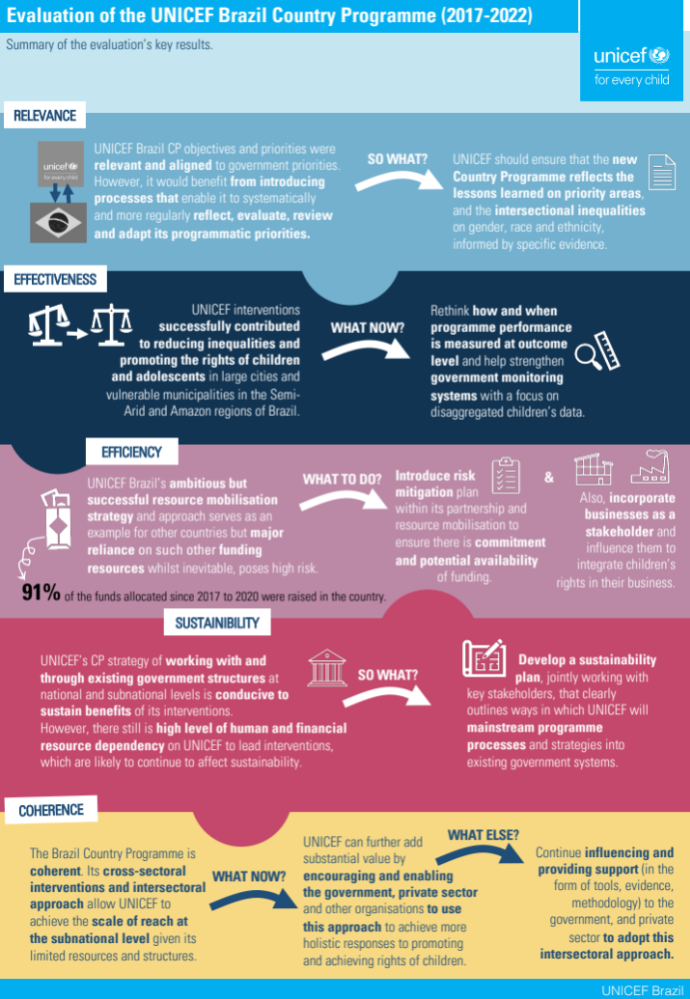
Infographic

Slide 27
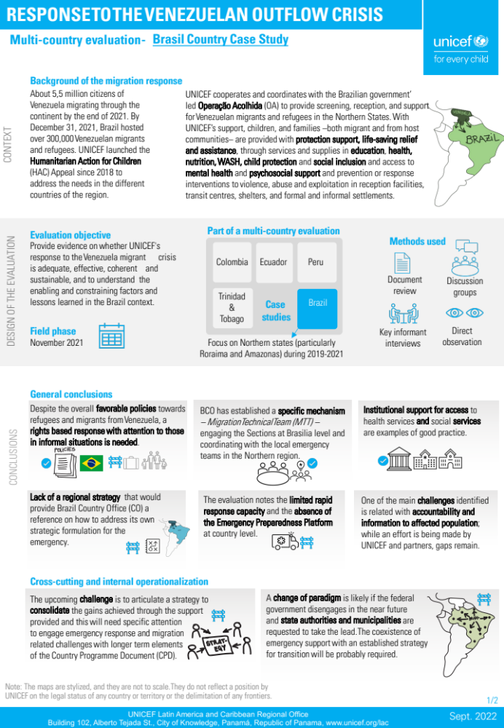
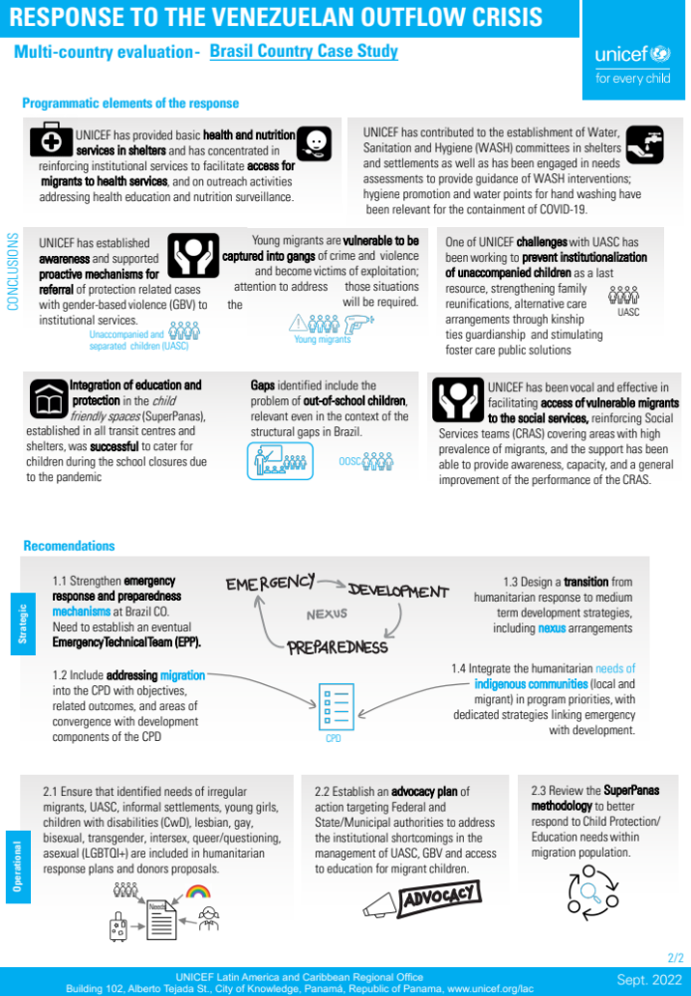

Slide 28
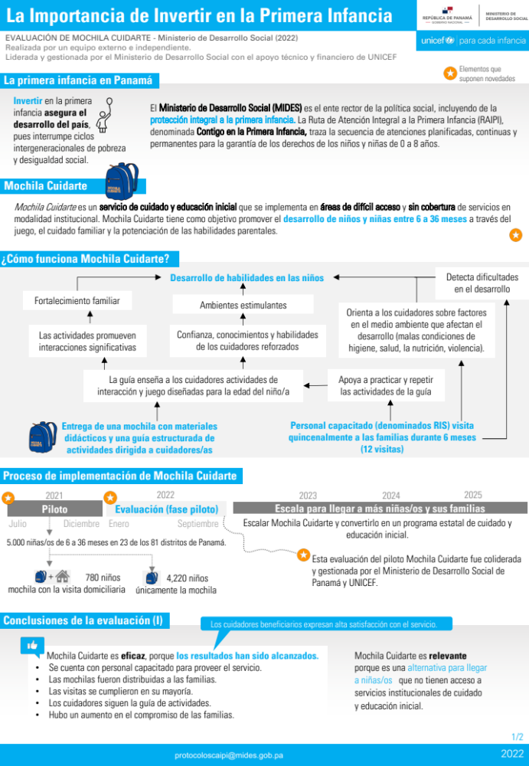
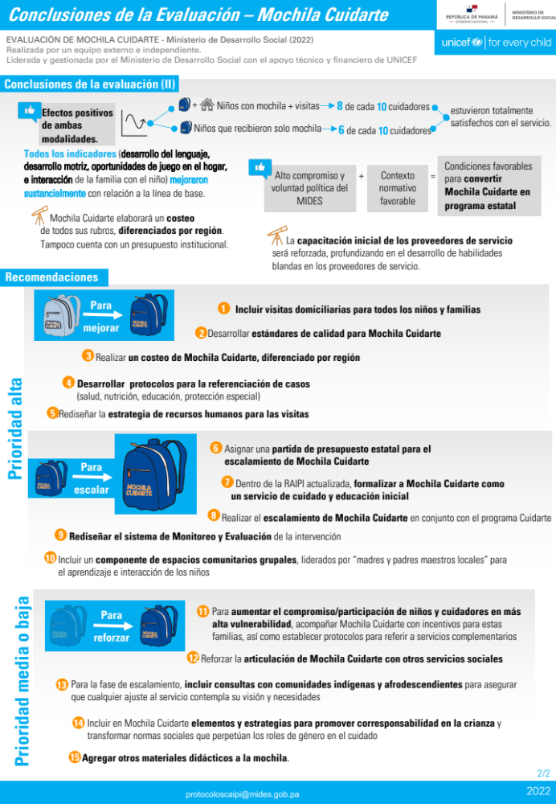
LESSONS LEARNED FROM USING DATA VISUALIZATION TO PROMOTE EVALUTION USE

Slide 29
LESSONS LEARNED FROM USING DATA VISUALIZATION TO PROMOTE EVALUTION USE
UNICEF Latin America and Caribbean Regional Office
Building 102, Alberto Tejada St., City of Knowledge, Panamá, Republic of Panama, www.unicef.org/lac
19

Slide 30
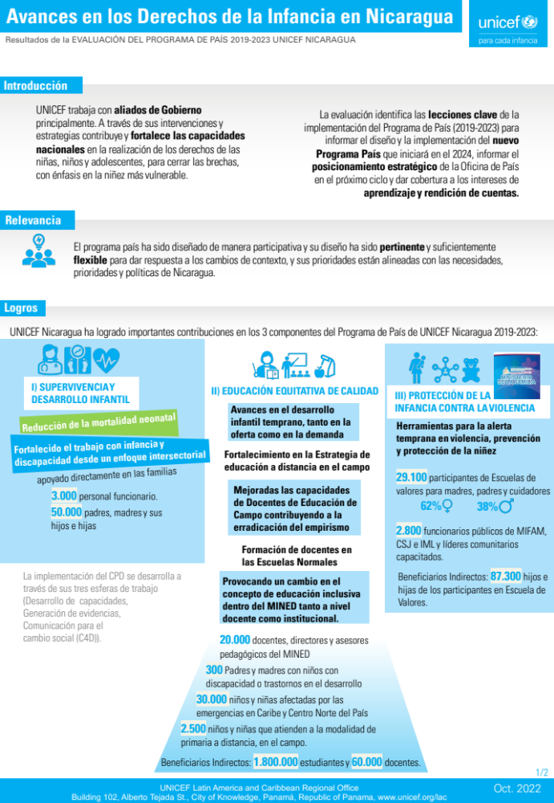
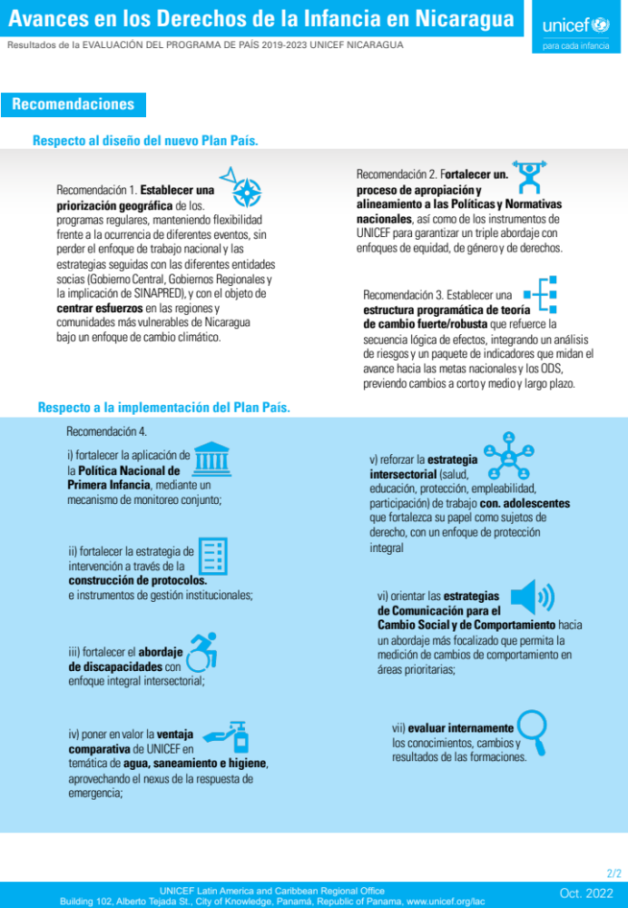
UNICEF Latin America and Caribbean Regional Office
Building 102, Alberto Tejada St., City of Knowledge, Panamá, Republic of Panama, www.unicef.org/lac
20

Slide 31
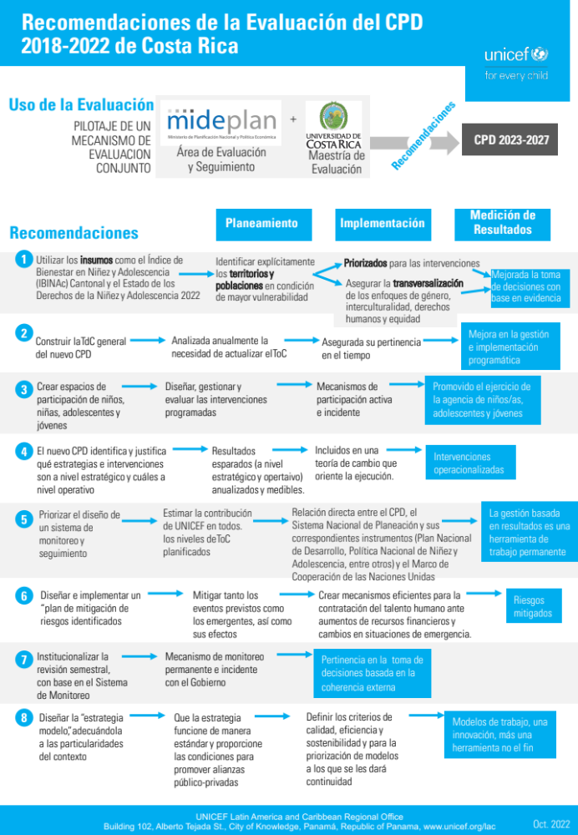
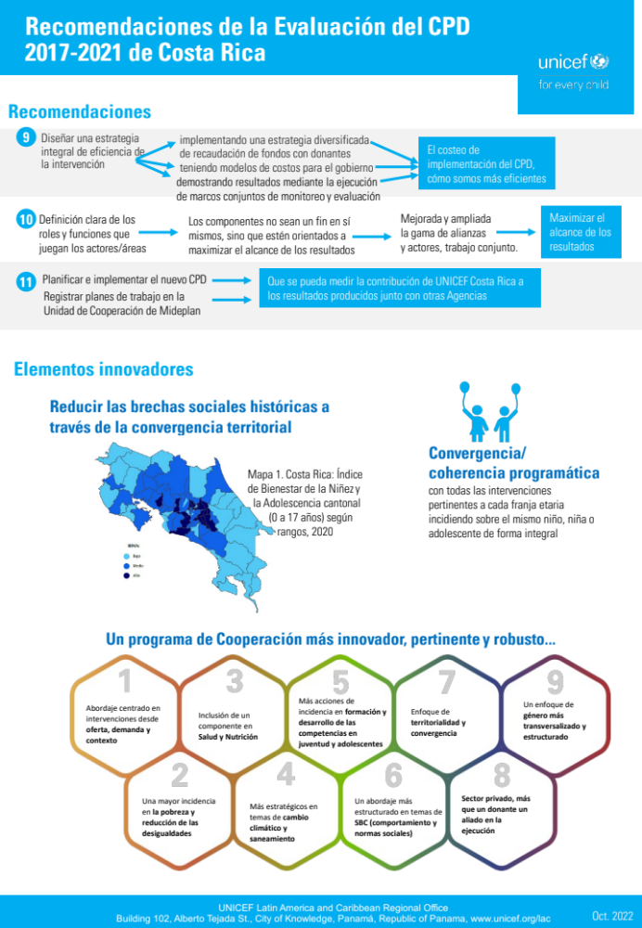
UNICEF Latin America and Caribbean Regional Office
Building 102, Alberto Tejada St., City of Knowledge, Panamá, Republic of Panama, www.unicef.org/lac
21

Slide 32
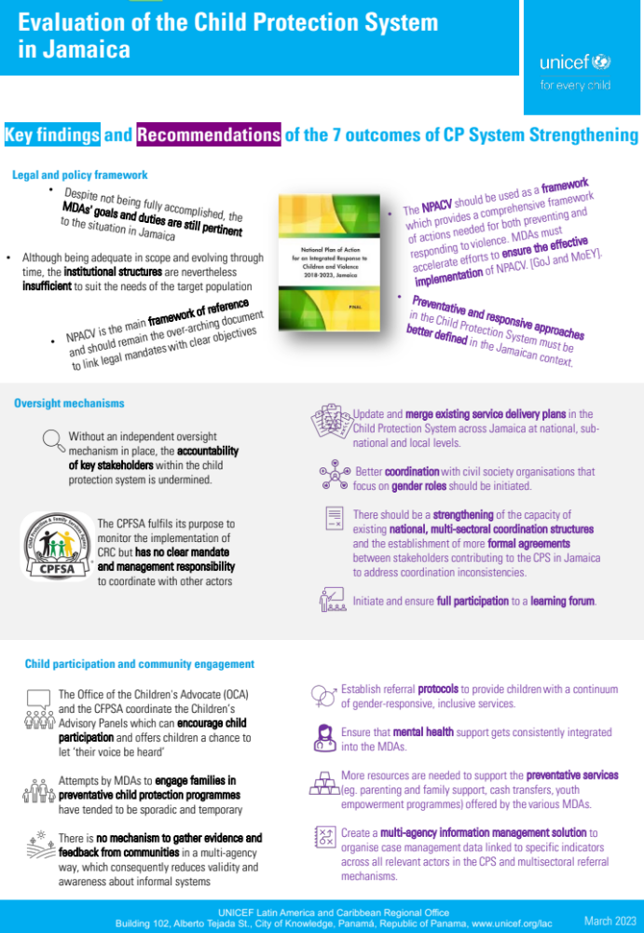
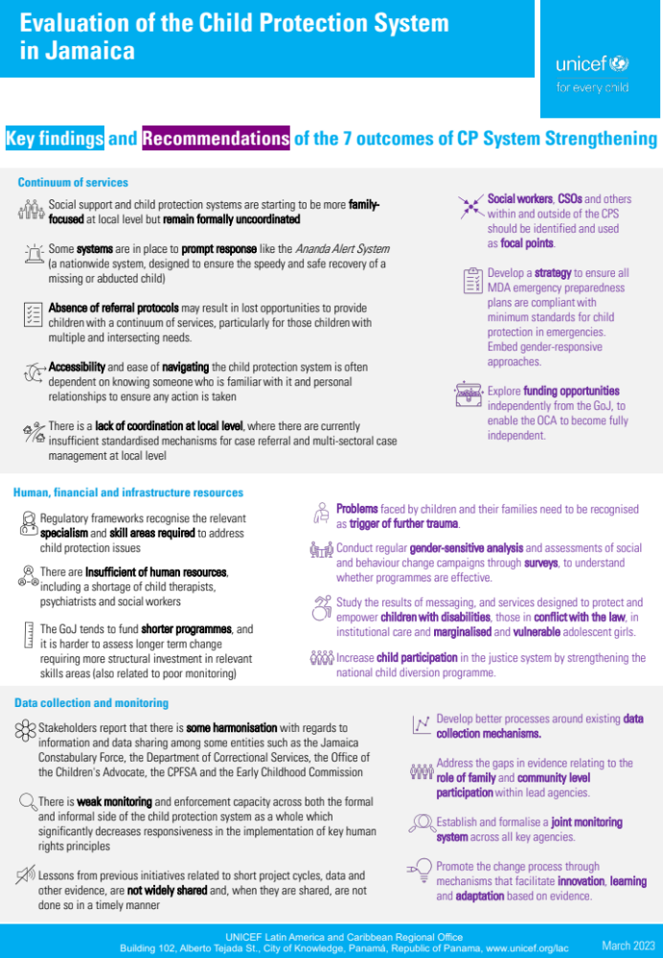
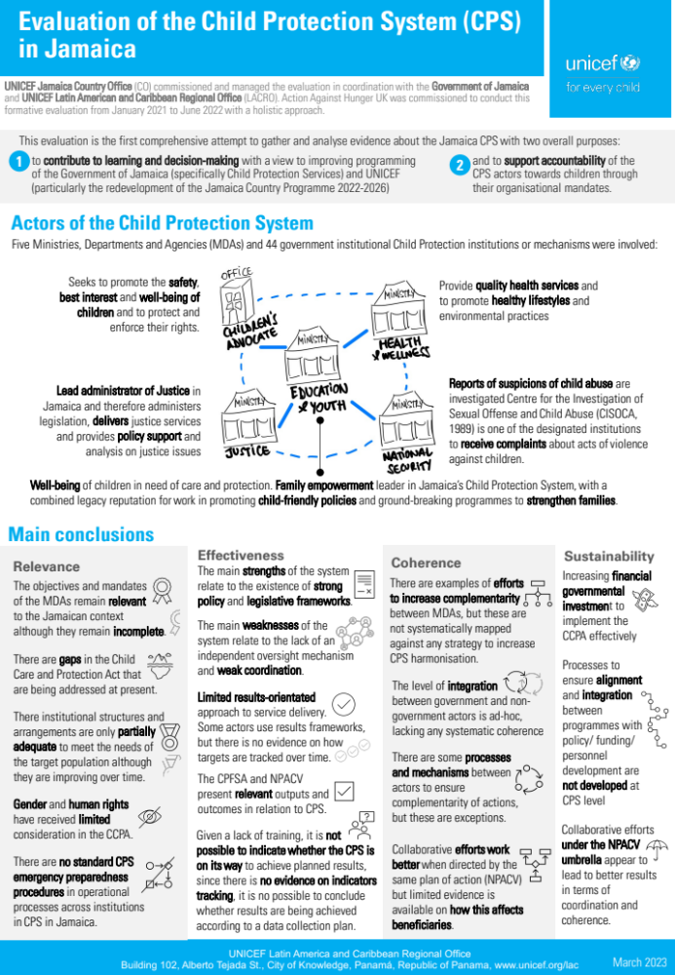
Infographic
UNICEF Latin America and Caribbean Regional Office
Building 102, Alberto Tejada St., City of Knowledge, Panamá, Republic of Panama, www.unicef.org/lac
22

Slide 33
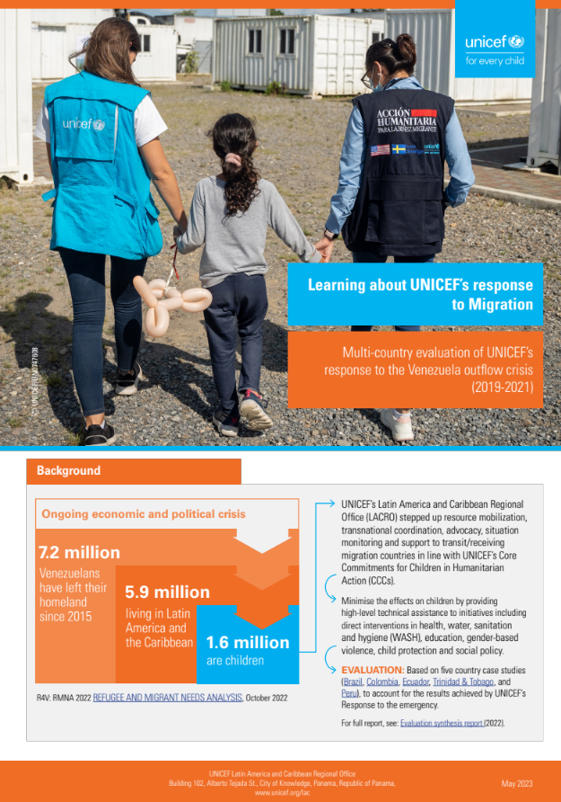
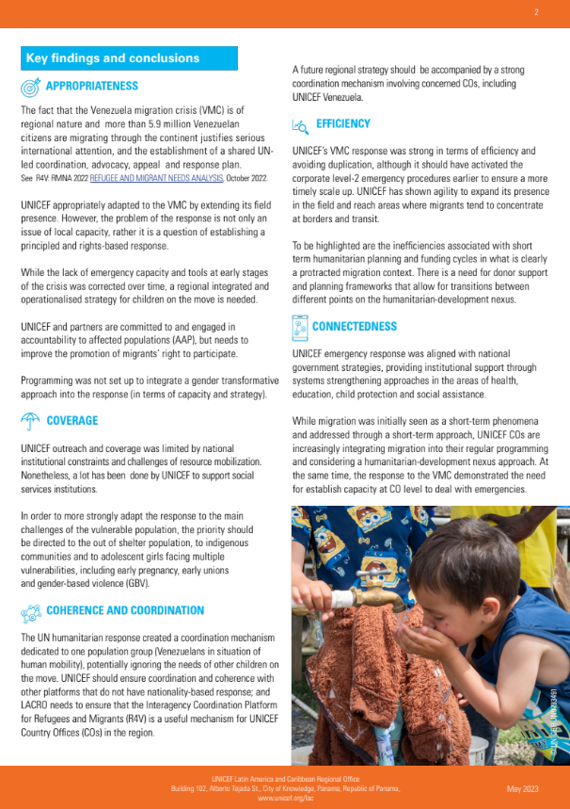
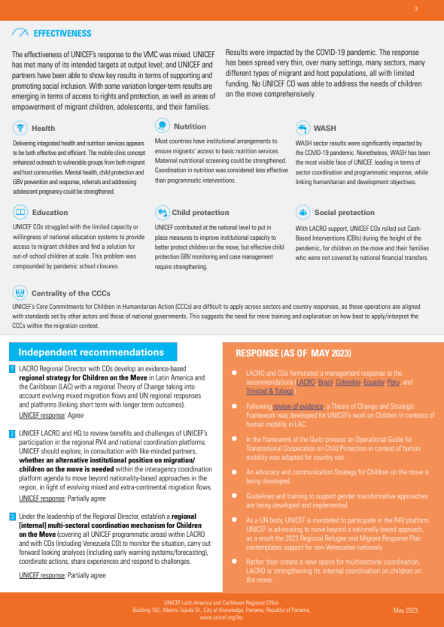
Infographic
UNICEF Latin America and Caribbean Regional Office
Building 102, Alberto Tejada St., City of Knowledge, Panamá, Republic of Panama, www.unicef.org/lac
23

Slide 34

UNICEF Latin America and Caribbean Regional Office
Building 102, Alberto Tejada St., City of Knowledge, Panamá, Republic of Panama, www.unicef.org/lac
25
Notes:
Standard First Slide with UNICEF logo and new signature and mother and child image.
Possible use: as screen image while people walk in.

Slide 35
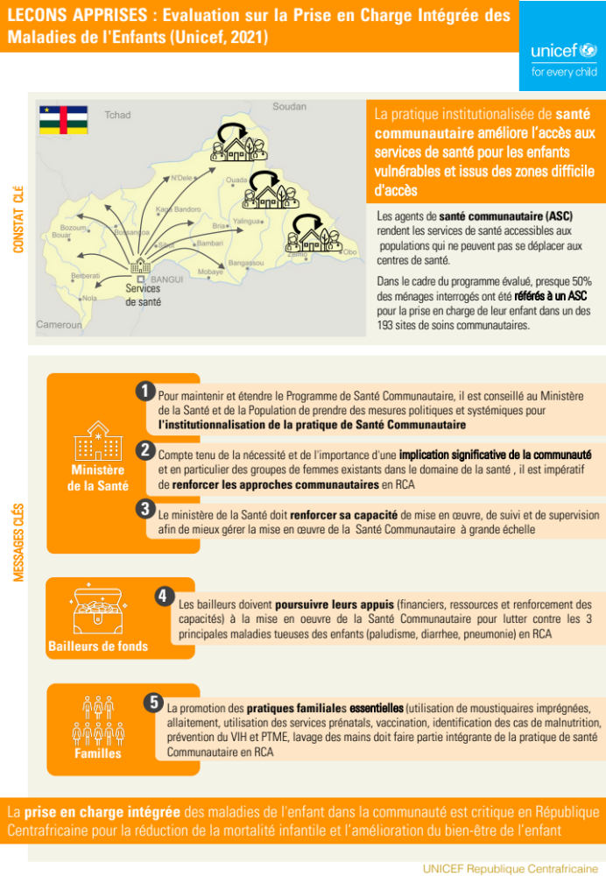
UNICEF Latin America and Caribbean Regional Office
Building 102, Alberto Tejada St., City of Knowledge, Panamá, Republic of Panama, www.unicef.org/lac
26
Notes:
Standard First Slide with UNICEF logo and new signature and mother and child image.
Possible use: as screen image while people walk in.

Slide 36
Infographic
UNICEF Latin America and Caribbean Regional Office
Building 102, Alberto Tejada St., City of Knowledge, Panamá, Republic of Panama, www.unicef.org/lac
27
Notes:
Standard First Slide with UNICEF logo and new signature and mother and child image.
Possible use: as screen image while people walk in.

Slide 37
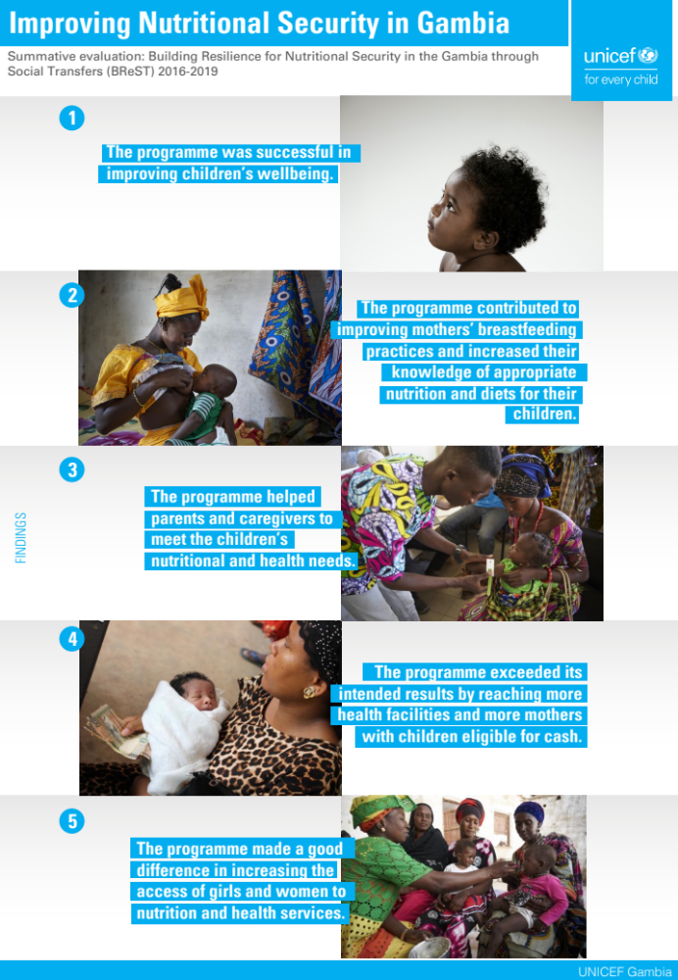
Infographic
UNICEF Latin America and Caribbean Regional Office
Building 102, Alberto Tejada St., City of Knowledge, Panamá, Republic of Panama, www.unicef.org/lac
28
Notes:
Standard First Slide with UNICEF logo and new signature and mother and child image.
Possible use: as screen image while people walk in.

Slide 38
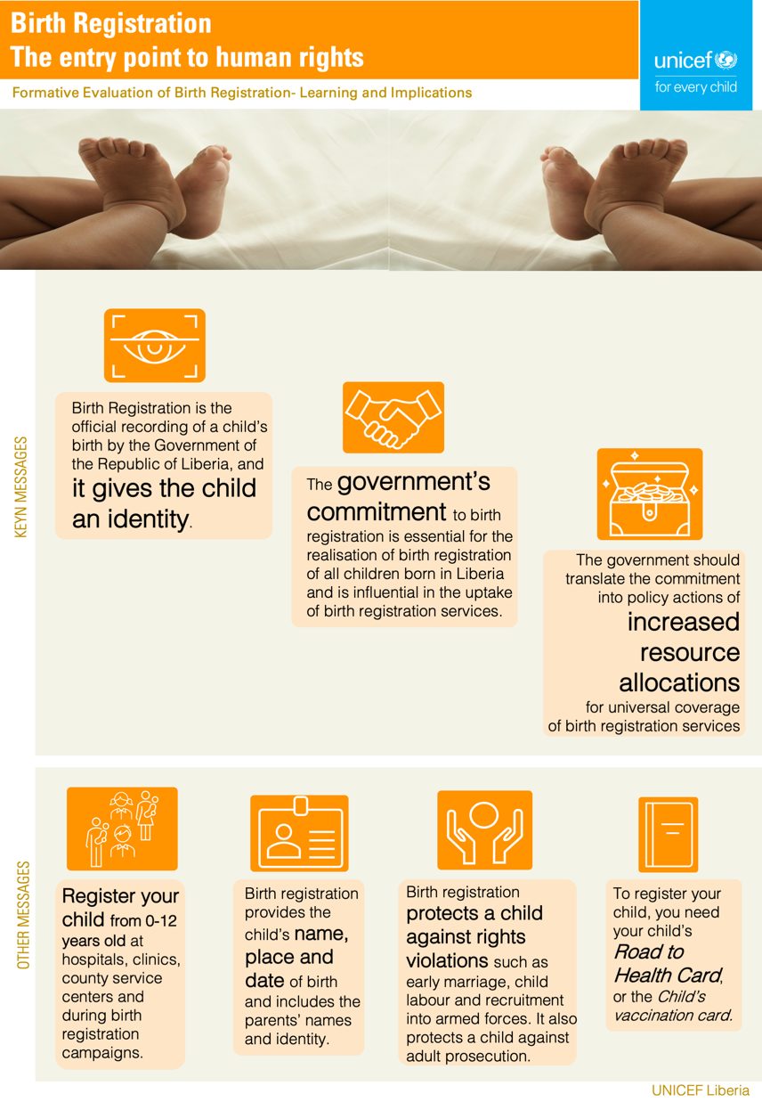
UNICEF Latin America and Caribbean Regional Office
Building 102, Alberto Tejada St., City of Knowledge, Panamá, Republic of Panama, www.unicef.org/lac
29
Notes:
Standard First Slide with UNICEF logo and new signature and mother and child image.
Possible use: as screen image while people walk in.

Slide 39


UNICEF Latin America and Caribbean Regional Office
Building 102, Alberto Tejada St., City of Knowledge, Panamá, Republic of Panama, www.unicef.org/lac
30
Notes:
Standard First Slide with UNICEF logo and new signature and mother and child image.
Possible use: as screen image while people walk in.

Slide 40

Policy .
Brief .
UNICEF Latin America and Caribbean Regional Office
Building 102, Alberto Tejada St., City of Knowledge, Panamá, Republic of Panama, www.unicef.org/lac
33

Slide 41



LESSONS LEARNED FROM USING DATA VISUALIZATION TO PROMOTE EVALUTION USE
Policy .
Brief .
Notes:
.

Slide 42


Evaluation .
Brief .
Notes:
.

