Slide 1
Hello there
Title 1 is here
Hello there
Hello there Hello there
Hello there Hello there
Hello there Hello there
Title 1 is here
Hello there
Hello there
Title 1 is here
Hello there
1
Title 2 is here
2
Title 1 is here
12
12
Title 1 is here
This rapid review could not identify any study that met all the above-mentioned criteria under Pillar 4, nor were studies identified covering Egypt during the specific time frame. This points to important gaps in the literature that will be further discussed in the next section and will be vital to developing the Impact Feasibility Assessment (IFA).
It would also be interesting to know the methods, platforms used to look for literature.
This rapid review could not identify any study that met all the above-mentioned criteria under Pillar 4, nor were studies identified covering Egypt during the specific time frame. This points to important gaps in the literature that will be further discussed in the next section and will be vital to developing the Impact Feasibility Assessment (IFA).
This rapid review could not identify any study that met all the above-mentioned criteria under Pillar 4, nor were studies identified covering Egypt during the specific time frame. This points to important gaps in the literature that will be further discussed in the next section and will be vital to developing the Impact Feasibility Assessment (IFA).

Slide 2
hey
Hello
Goodbye

Slide 3
hey
Hello
Goodbye

Slide 4
hey
Hello
Goodbye

Slide 5





How you doing?

Slide 6
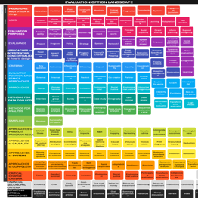
THE SEA
Wonderful

Slide 7
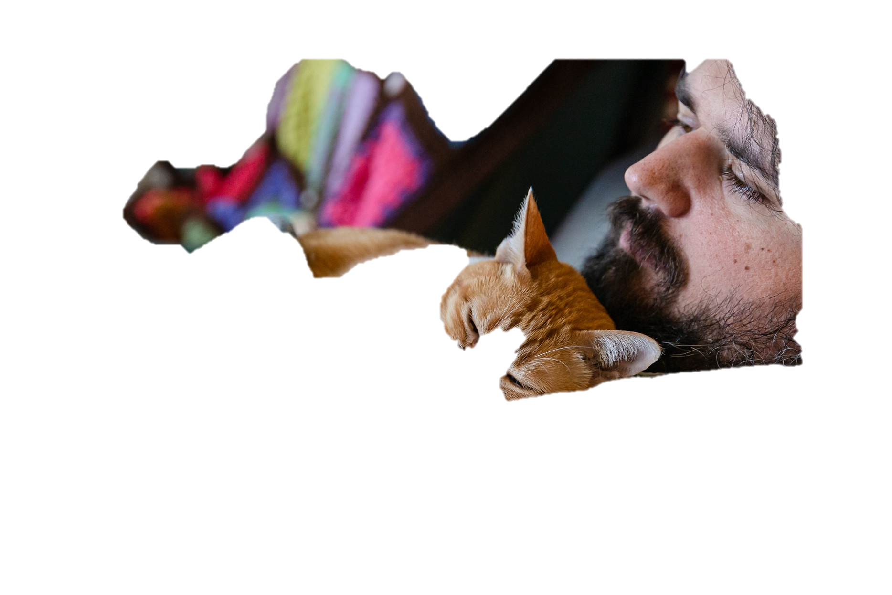




Slide 12


